Slide 1


Demand and Supply - Rare Earth Metals and Magnets in India
An overview
Date: 16th May 2026
By Sanjay Arya

Slide 2
Hello everyone. Thank you for being here today.
Today, we will explore a critical yet often overlooked area of our modern technological landscape: rare earth metals. These elements play an indispensable role in the manufacturing of a wide array of products that we rely on every day, from smartphones and electric vehicles to renewable energy technologies and advanced defense systems.
Despite their name, rare earth metals are not as rare as they seem; however, the challenges associated with their extraction, processing, and supply chain management make them a focal point for global economic and strategic interests.
In this presentation, we will discuss the current demand and supply situation for rare earth metals, particularly in India. We’ll examine key factors driving demand, the government's initiatives to boost domestic production, and the roles that private enterprises are playing in this sector. We will also touch on the global context, including how international dynamics affect India's position in the rare earth market.

Slide 3

Brief Introduction
DK Metal World Limited was established in Hong Kong, as one of the Director myself Sanjay Arya has over 35 years of experience in International trading of various metals, ores, ferro alloys etc.
Having worked in India, and then in Seoul, Korea. Hong Kong, China is adopted place for work. Over the years we established good relations and made friends in all regions especially in China and Korea.
Apart from trading in metals, minerals and alloys, our group of companies is involved in Processing of metals and metal plating for various industries in India. Apart from recent venture in USA for trade of metals, we are venturing in Recycling industry with first factory in India.

Slide 4
Current affairs – An Overview
My dear Brothers and Sisters, we are faced with uncertain times. the world is being shaped by two overlapping, high‑intensity conflicts—the continuing Russia–Ukraine war and the U.S.–Iran war—and their knock‑on effects on security, trade, energy, food security, and global diplomacy.
As of 04/27/2026 the world is being shaped by two overlapping, high‑intensity conflicts—the continuing Russia–Ukraine war and the U.S.–Iran war—and their knock‑on effects on security, trade, energy, food security, and global diplomacy. Brief, sourced summary and the main global impacts:
Apart from Energy markets and resulting inflation. Shipping and trade routes are disrupting supply chains (especially energy and commodities shipped from the Gulf), and forced some buyers to seek alternative supply routes or emergency stockpiles. That raises costs for manufacturers and consumers globally. These conflicts are creating Food insecurity and Humanitarian crisis since 2022, for import dependent countries, costs of food, fertilizers and now fuel is making countries vulnerable. These conflicts are creating crises and displacing large population internally and abroad.
The wars have hardened blocs and complicated diplomacy: Western states remain committed to supporting Ukraine while simultaneously managing the Middle East crisis and balancing risks of wider escalation. Some states (regional and global) seek to mediate or take advantage of openings in energy and trade; China, India and other major importers have been recalibrating procurement and diplomatic stances. Sanctions, export controls, and rerouted trade are reshaping some strategic supply chains.

Slide 5
Economy, GDP and Growth Overview
As of 2026, India is one of the world's fastest-growing major economies, characterized by a diverse economic structure that includes agriculture, manufacturing, and services. The country has shown resilience in the face of global economic challenges, with a projected GDP growth rate of around 6-7% for the fiscal year. Key drivers of this growth include strong domestic consumption, government reforms, and increased foreign direct investment (FDI).
Key Highlights:
  India is the fifth-largest economy in the world by nominal GDP, having surpassed the United Kingdom and France.
  The country is also projected to rank third in the world by purchasing power parity (PPP).
:

Slide 6

Sectoral Contributions and Challenges
  The services sector remains a significant contributor to GDP, accounting for approximately 55% of India’s economic output. Information technology, telecommunications, and financial services are leading areas.
Manufacturing and agriculture continue to play vital roles, with initiatives like "Make in India" promoting local production.
  Despite its growth, India faces challenges such as inflationary pressures, unemployment, and disparities in regional development.
  Structural reforms are ongoing to enhance the ease of doing business, improve infrastructure, and attract investments.

Slide 7

Global Context:
  India is increasingly recognized on the global stage, with participation in various forums like G20, BRICS, and the Quad.
  The country is seen as a critical player in the global supply chain, particularly in sectors like technology and renewable energy.
In conclusion, India's robust economic growth and strategic reforms position it as a key player in the global economy. Its ability to navigate challenges and harness opportunities will significantly influence its ranking and role in the coming years.

Slide 8

Recent Trends
India has continued to exhibit strong GDP growth of 6-7% for fiscal year.
Key Sectors Driving Growth
Services Sector: Contributes to over 55% of GDP, with IT and business services leading the way.
Industry: Manufacturing and construction are showing robust growth, supported by the “Make in India” initiative.
Agriculture: Continues to be a significant sector, employing nearly half of the workforce, though its contribution to GDP is gradually declining.

Slide 9

Renewed Initiatives of Government
Foreign Direct Investment (FDI)
FDI inflows have increased, reflecting confidence in India’s economic potential. The government has relaxed regulations in several sectors, to attract more foreign investments, particularly in technology and renewable energy.
Digital Transformation
E-commerce and fintech sectors have experienced exponential growth, reflecting changing consumer behavior.
Infrastructure Development
There are ongoing government initiatives to enhance infrastructure, including transportation, energy, and urban development. Investment in infrastructure is seen as critical for stimulating economic growth and attracting investment.
Global Supply Chain Resilience
India's role in global supply chains is evolving, with efforts to diversify sourcing away from overly dependent regions. The government’s focus on self-reliance (Atmanirbhar Bharat) encourages local production and reduces import dependency.

Slide 10
Introduction: Definition of Rare Earth Metals
Rare earth metals, also known as rare earth elements (REEs), are a group of 17 chemically similar metallic elements found in the f-block of the periodic table. This group includes the 15 lanthanides (lanthanum to lutetium) along with scandium and yttrium. Though available in abundance in the Earth's crust; their extraction and processing are complex and costly, hence the word “Rare”.
Usage and Significance
Electronics, smartphones, tablets, screens and batteries
Defence and Aerospace, military systems and weapons and advanced communication
High performance magnets
Catalysts and lighting

Slide 11
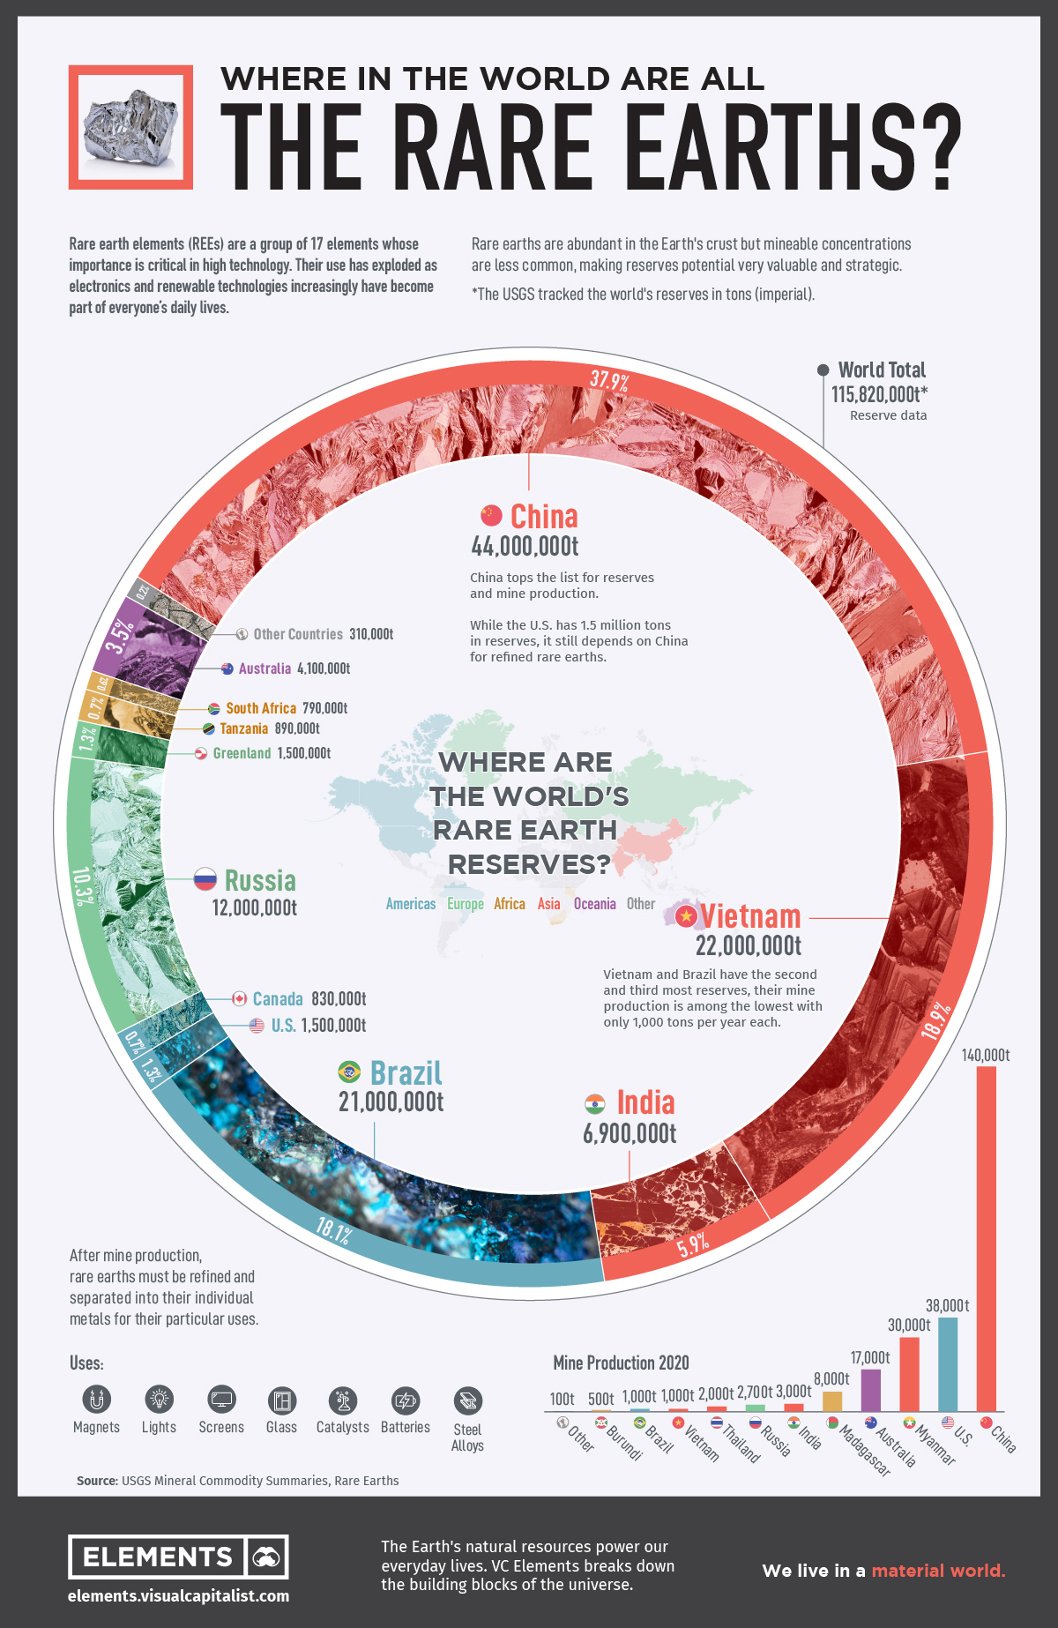
World Reserves for Rare Earth

Slide 12

Global Overview
The Global Rare Earths Metal Market is valued at USD6-14.0 Billion in year 2024-25, and is projected to grow significantly to over USD30 billion in year 2034-36, driven by demand for electric vehicles, wind turbines and electronics.
Major producers of Rare Earths Metals are China, USA, Vietnam, Australia, Myanmar. Small producing countries include India, Brazil, Madagascar etc.
Asia Pacific dominated the rare earth elements market with an 86.70% share in 2025, driven by strong demand from the electronics, automotive, and construction sectors, particularly in China and India.
By type, Neodymium is expected to retain the largest market share in 2026, supported by rising demand from hybrid and electric vehicle manufacturers for permanent magnet applications.
Current distribution
Industry wise:

Slide 13
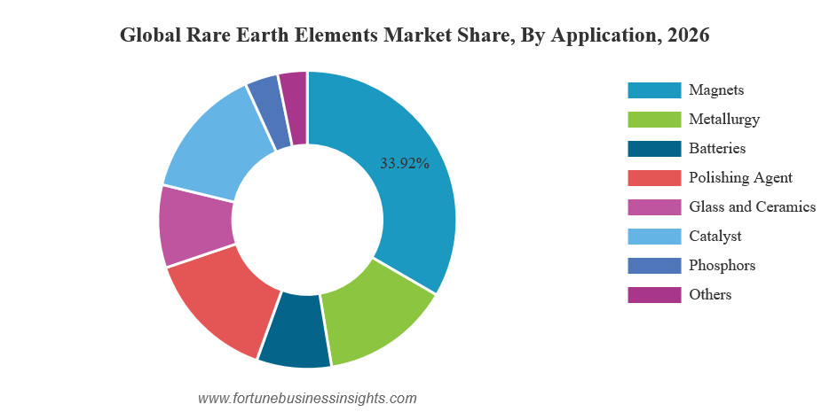
Current distribution:

Slide 14
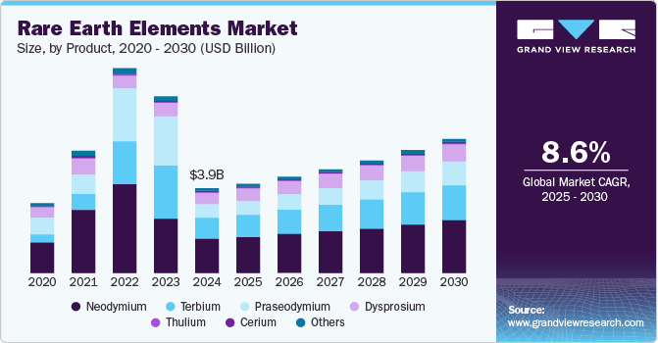
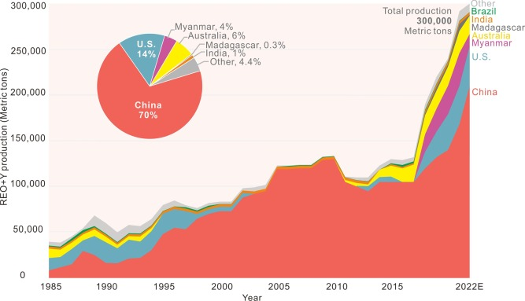
World’s Production and Contribution - Country-Wise

Slide 15
Key Market Drivers:
Electric Vehicle Expansion: Particularly Neodymium, praseodymium, dysprosium and terbium based rare earth permanent magnets are majorly used for this purpose.
Defence & Aerospace: Rare earth are crucial in advanced military technology, driving significant specialized demand.
Electronics & Technology: Rising adoption of smartphones, laptops etc.necessiatates rare earth elements for components like actuators, speakers, screen displays etc.
Renewable energy: The shift towards green energy drives demand for rare earth based generators in wind turbines.
Geopolitical Supply Chain Diversification: Due to China’s dominant market share (over 90%), countries like US, Japan and China are investing in domestic mining, processing and recycling to secure supplies.
Industrial Automation and Robotics: Increasing use of robotics and factory automation relies on high efficiency, compact, high torque rare earth based magnets.

Slide 16

Indian scenario
India has a substantial base of rare earth minerals, particularly monazite deposits located across several coastal and inland regions. These deposits contain about 13.15 million tonnes of of monazite, estimated 7.23 million tonnes of rare earth oxides.
In addition, 1.29 million tonnes of in-situ REO resources have been identified in hard rock area of Gujarat and Rajasthan states.
While India has a strong rare earth resource base, domestic production of permanent magnets is still developing. Imports continue to meet a large part of current requirements, with major share from China. Import dependence is around 84.8% value wise and 90.4% quantity-wise.

Slide 17
National Priorities and Initiatives
Domestic REPM manufacturing capacity supports several national priorities, as these magnets are essential for strategic and high tech sectors. Indian Government initiative aims to strengthen domestic production, enhance supply chain resilience for rapidly expanding industries.
National Critical Minerals Mission (NCMM), approved in January 2025, aims to secure a long term sustainable supply of critical minerals and strengthen country’s critical mineral value change from mineral exploration and mining to beneficiation, processing and recovery from end-of-life products.
India’s strategy to advance self-reliance, accelerate clean energy adoption, support advanced mobility and strenghtn defence and strategic manufacturing ecosystems.

Slide 18

Government Initiatives
To strengthen India’s self-reliance in critical materials, the government on 26TH November, 2025, approved a major scheme for Rare Earth Permanent Magnets (REPMs). This initiative provides financial support and incentives to build a fully integrated domestic manufacturing ecosystem.
Financial Outlay: ₹7,280 crore
Capacity Creation: 6,000 MTPA integrated manufacturing capacity of sintered REPMs, distributed among up to five beneficiaries through global competitive bidding
Incentives: ₹6,450 crore in sales-linked incentives over five years
Capital Subsidy: ₹750 crore to support advanced facilities
Timeline: Two-year gestation for setup, followed by five years of incentive disbursement linked to production

Slide 19
New Corridor announced
To complement the REPM scheme, the Union Budget 2026–27 announced Dedicated Rare Earth Corridors in Odisha, Kerala, Andhra Pradesh, and Tamil Nadu. These corridors will focus on mining, processing, research, and manufacturing, leveraging the mineral-rich base of these states. The initiative is expected to generate stronger local economies, enhance R&D capacity, and integrate India more deeply into global advanced-materials value chains.

Slide 20
Developments in Production:
Trafalgar Rare Earth Alloys Pvt. Ltd. (TREAPL), is establishing India's first integrated rare earth metals, alloy, and magnet plant in Gujarat. This project aims to create a fully vertically integrated supply chain.
The Rare Earth Theme Park Initiative will establish pilot plants and demonstration facilities across the value chain, fostering entrepreneurship and skills development.
Odisha Sands Complex (OSCOM) a flagship unit of Indian Rare Earths Limited (IREL) is expanding its processing capacity (notably for mixed rare earth chlorides) and upgrading its mineral handling infrastructure (including a private freight terminal and a new de-salination plant). A planned Rare Earth Permanent Magnet plant will produce 3,000 kilograms of magnets for defence and clean energy applications. Joint ventures, such as IREL-IDCOL, are building new mining and separation plants to mine coastal sand deposits in Odisha.
In Bhopal, a proposed Rare Earth and Titanium Theme Park aims to commercialize laboratory-scale technologies for extraction and processing, creating an innovation hub for the sector.
.

Slide 21
Key Partnerships and Projects
Toyota Rare Earths India Pvt. Ltd. (TREI): A subsidiary of Toyota Tsusho Corporation, it has operated a rare earths manufacturing unit in the Andhra Pradesh Special Economic Zone (APSEZ) since 2013.
Proterial Evaluation: Former Hitachi Metals unit Proterial is evaluating manufacturing rare earth magnets in India to support the electric vehicle (EV) supply chain.
Strategic Collaboration: The India–Japan Clean Energy Partnership and various MoUs support joint ventures between Indian state-run IREL (India) Limited and Japanese firms
Supply Security: Japan imported over 1,000 metric tonnes of rare earths from India in 2024, accounting for a significant portion of IREL's output.
Rising Interest: Several major Japanese companies—including Panasonic, Sumitomo Metals and Mining, and Nichia—have explored partnerships in India for EV batteries and critical minerals
.Location Focus: Efforts are focused on exploring hard rock rare earth deposits in Rajasthan and Gujarat.

Slide 22
New Developments
India has approved a 72.8 billion rupees ($815.74 million) rare earth permanent magnets manufacturing programme, in an effort to cut reliance on imports for the elements critical to sectors ranging from electric vehicles and aerospace to defence and renewable energy.
India's consumption of rare earth permanent magnets - one of the strongest types of permanent magnets - is expected to double by 2030, but it currently meets its demand primarily through imports.

Slide 23
Rare Earth Production and Deposits
India has significant reserves of rare earth elements (REEs), with an estimated 6.9 million metric tons of rare earth reserves, accounting for 6% of the world's total reserves. The country ranks fifth in the world in terms of rare earth reserves, after China, Vietnam, Brazil, and Russia ¹.
Rare Earth Reserves in India:
  Total Reserves: 6.9 million metric tons
  Global Ranking: 5th
  Percentage of Global Reserves: 6%
  Main Sources: Monazite-bearing beach sand deposits in Kerala, Tamil Nadu, Odisha, Andhra Pradesh, Maharashtra, and Gujarat
  Available REEs: Lanthanum, Cerium, Neodymium, Praseodymium, and Samarium
  Unavailable REEs: Dysprosium, Terbium, and Europium (classified as Heavy Rare Earth Elements)

Slide 24
Main Players in Indian Market
India has a significant presence in the rare earth industry, with several key players involved in mining, refining, and producing rare earth elements and compounds. Here are some notable rare earth producers in India.
Indian Rare Earths Limited (IREL): A Public Sector Undertaking under the Department of Atomic Energy, IREL is the sole producer of rare earth compounds in India. They operate several units, including:
Odisha Sand Complex (OSCOM): A rare earth extraction plant in Odisha that produces mixed rare earth chloride.
Rare Earth Division (RED): A plant in Aluva, Kerala, that produces high-purity rare earth oxides and compounds.
Manavalakurichi unit: A unit in Tamil Nadu that produces high-purity individual rare earth compounds.
Rare Earth Permanent Magnet (REPM) Plant: A plant in Vizag that produces rare earth permanent magnets.
Toyotsu Rare Earths (India) Pvt. Ltd.: A company that has partnered with IREL to create a critical minerals supply chain and remarket rare earth oxides and carbonates.
  Rare Earth Minerals: A company based in Rajsamand, Rajasthan, that processes, supplies, and exports rare earth minerals like abrasive garnet sand, quartz stone, and quartz powder.
These companies contribute to India's growing rare earth industry, which is expected to play a significant role in the country's economic development and technological advancements.

Slide 25

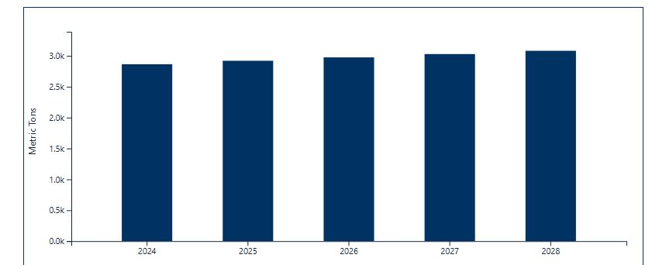
Production Forecast in India:
Year | Metric Tons (Forecast)
2028 | 3081.20
2027 | 3028.49
2026 | 2974.71
2025 | 2919.83
2024 | 2863.83

Slide 26

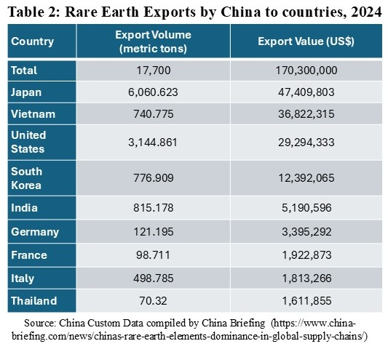
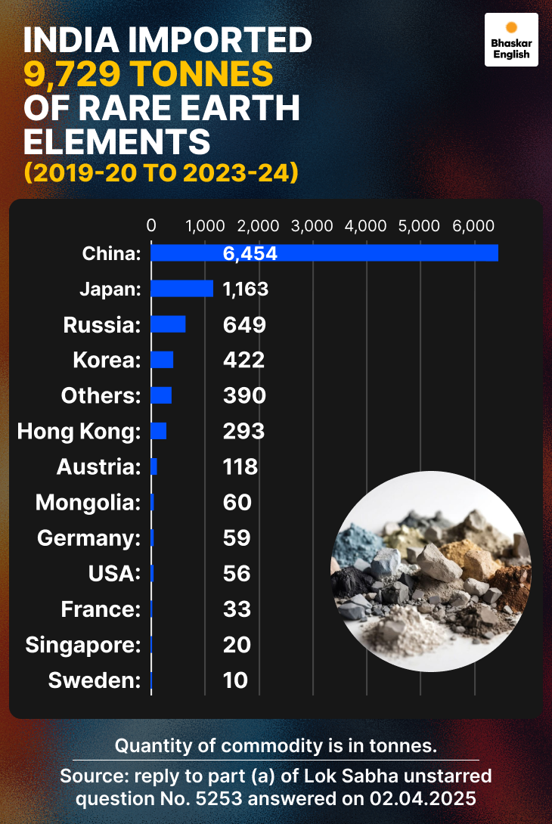
China exports and India imports:

Slide 27
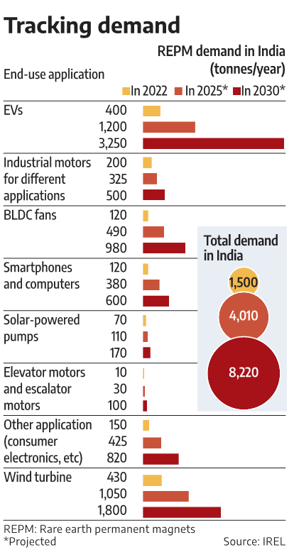
Current and Projected Demand in India

Slide 28
Summary
As we’ve explored today, Rare Earths metals are not “Rare” in usage but these are versatile material with significant potential across various industries. From automotive to aerospace to defense to cutting edge technology, the opportunities for further innovation are immense.
I encourage you to take an active part in the discussion following my presentation. Your questions and perspectives are invaluable as we work together to explore new opportunities within our field.

Slide 29
Cooperation is only way
DESPITE OUR DIFFERENCES AND INHERENT COMPETITION, China and India are the biggest markets today in terms of population.
India and china can be complementary – india as a services/manufacturing partner and consumer market; china as tech and capital provider in many sectors, though geopolitics complicate ties.
Timing: Near term china remains dominant in capital goods and high-tech manufacturing; india’s structural advantages position it for stronger medium-term gains if reforms, infrastructure and skills scale quickly.
Our cooperation is essential and it matters…..
Global stability, supply chain resilience, climate action, joint economic growth, joint projects, scientific exchange, trade facilitation and many more areas of rules-based cooperation that manages rivalry can unlock large mutual and global benefits while lowering systemic risks.

Slide 30
Concluding remark:
Rare earth metals are no longer niche inputs but strategic enablers of clean energy, advanced electronics, defense systems, and the technologies that will define the 21st century. Securing resilient, diversified supply chains—through responsible domestic development, trusted alliances, recycling, and material‑efficient design—reduces risk and strengthens economic and national security. Investment in sustainable mining practices, next‑generation processing, and circular‑economy solutions will lower environmental costs while ensuring long‑term access. Policymakers, industry, and researchers must act together now to balance competitiveness, sustainability, and resilience. Thank you — I welcome your questions.
I Thank Asian Metals for giving this opportunity to be among you and present my views on Rare Earth metals growth story. Also thanks to Ms. Vivian and to some of the papers & data published by some renowned publications of India and World.

